Slide 1
Android

Slide 2
Agenda
ListView
GridView
Creating New Activity
Intents
Menus
Options Menu
Sub Menu
Context Menu
SQLite
SQLiteOpenHelper
SQLiteDatabase
Cursor
Movies Example

Slide 3
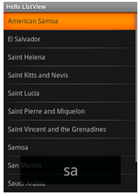
ListView
ListView is a ViewGroup that creates a list of scrollable items.

Slide 4
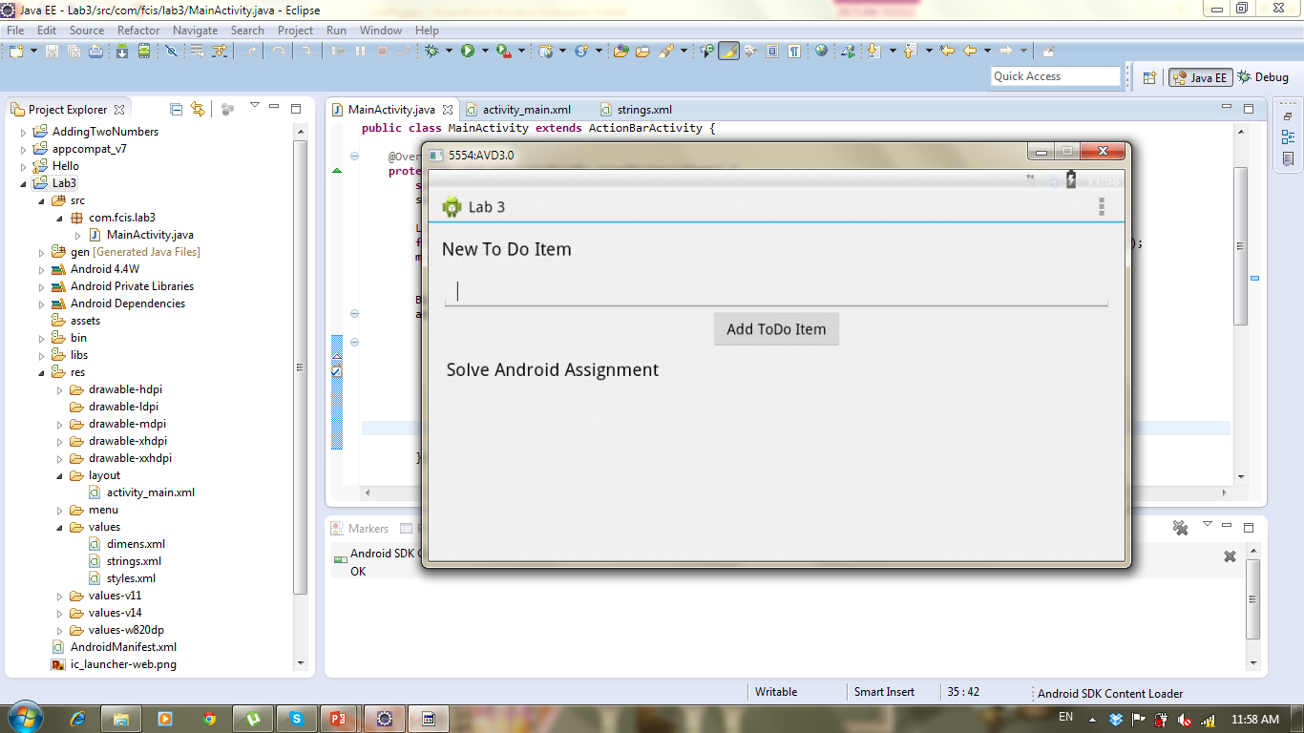
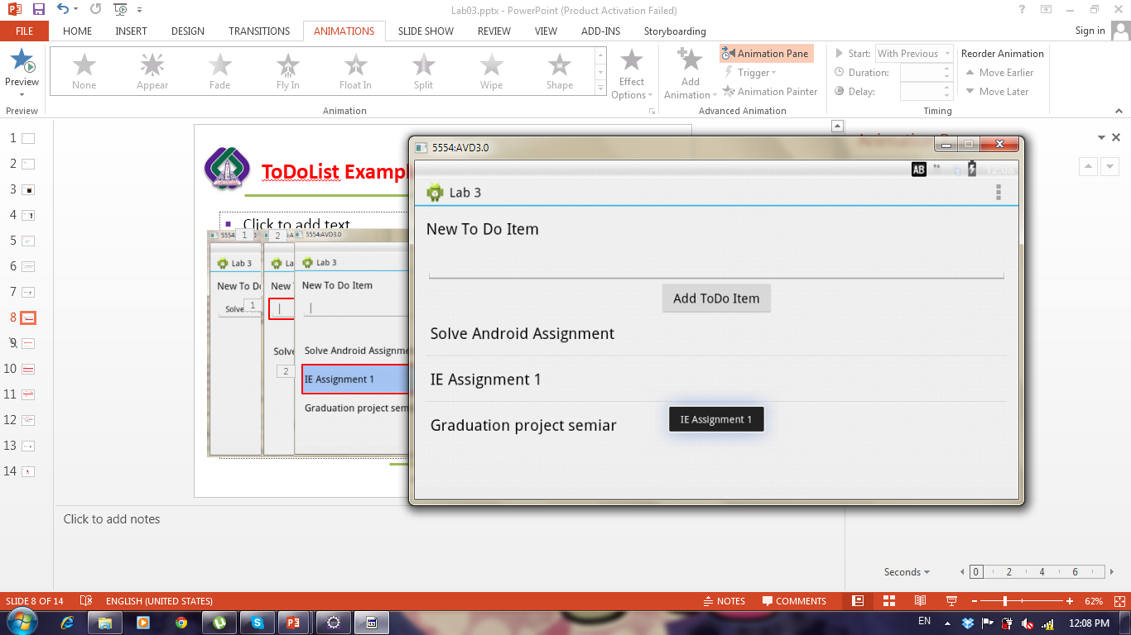
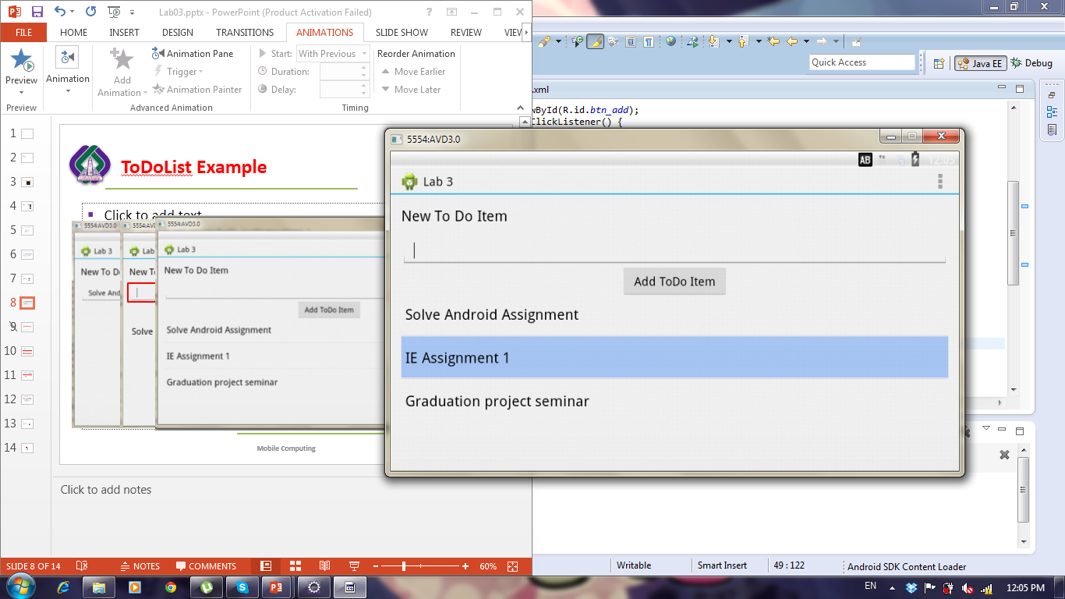
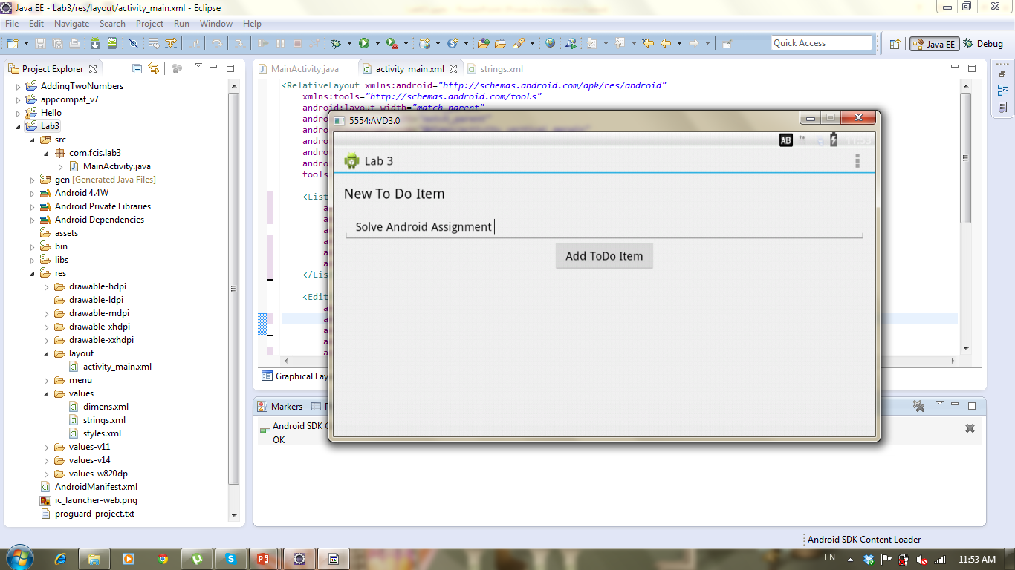
Application

Slide 5
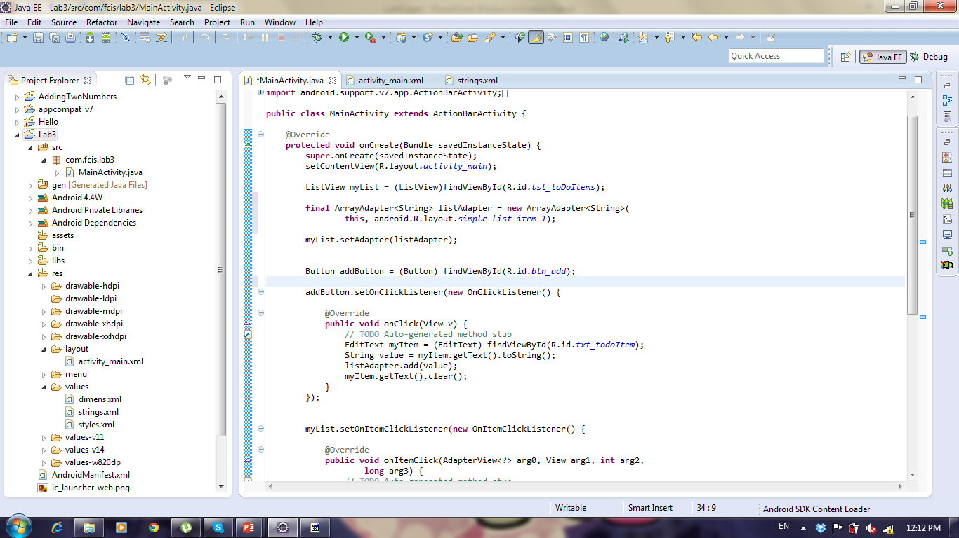
Get Listview
Generate adapter to bind values to listView
Set ListView’s adapter with our adapter
Get button and add click listener
Get Text from edittext, add it to adapter then clear edittext
Notes:
ArrayAdapter<String>aa=new ArrayAdapter<String>(getApplicationContext(), android.R.layout.simple_list_item_single_choice,ss);
lv.setChoiceMode(ListView.CHOICE_MODE_SINGLE);
Adapters are not only used by ListView, but also by other views which extend AdapterView as, for example, Spinner, GridView, Gallery and StackView.
To add or delete item the adapter should be linked with arrayList not String[]
https://github.com/codepath/android_guides/wiki/Using-an-ArrayAdapter-with-ListView

Slide 6
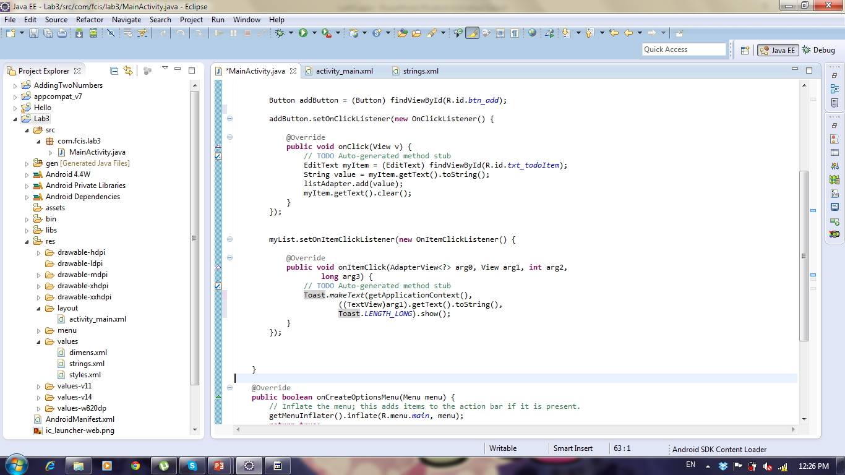
Application: How to show todoitem text when clicking it using Toast
Add itemClickListener On ListView
Show Message to user using Toast Class

Slide 7
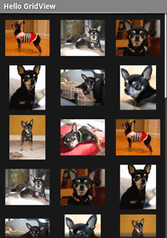
GridView
GridView is a ViewGroup that displays items in a two-dimensional, scrollable grid.

Slide 8
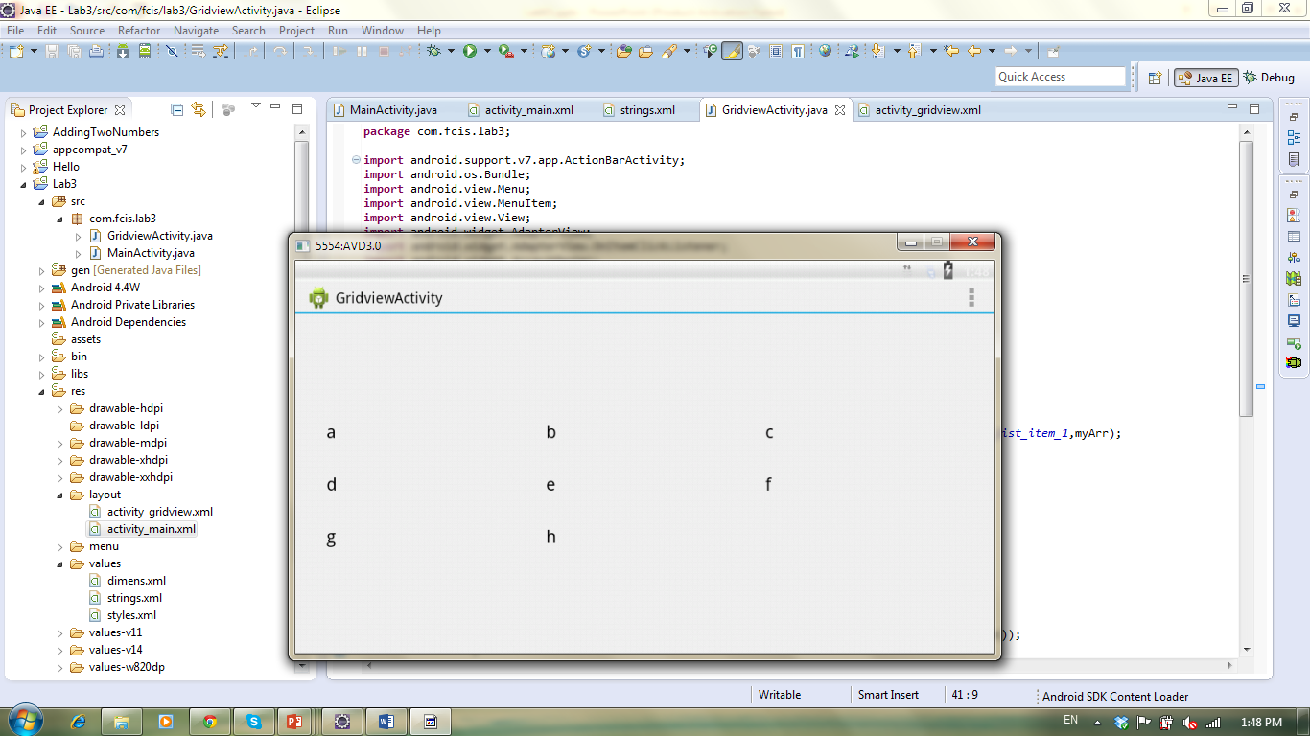
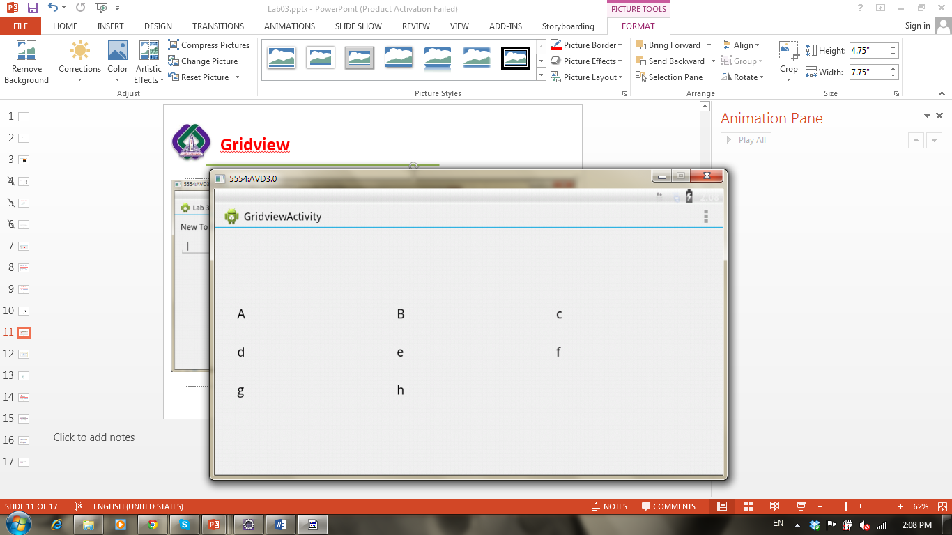
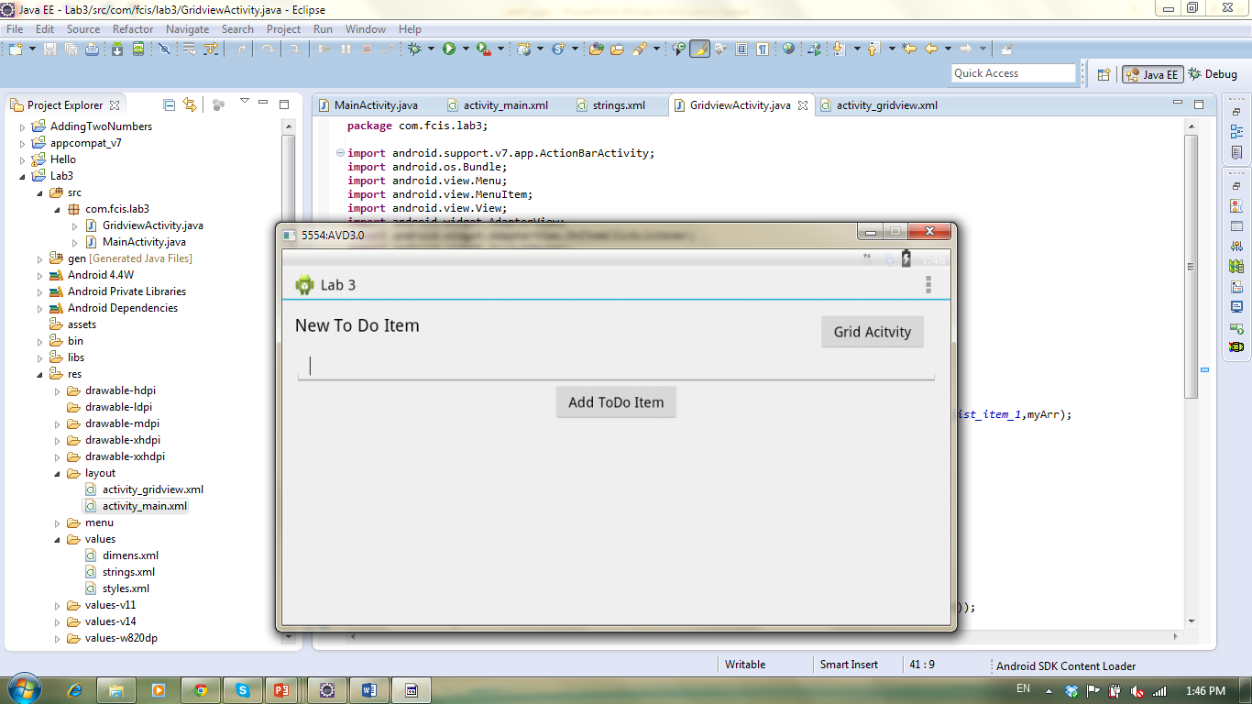
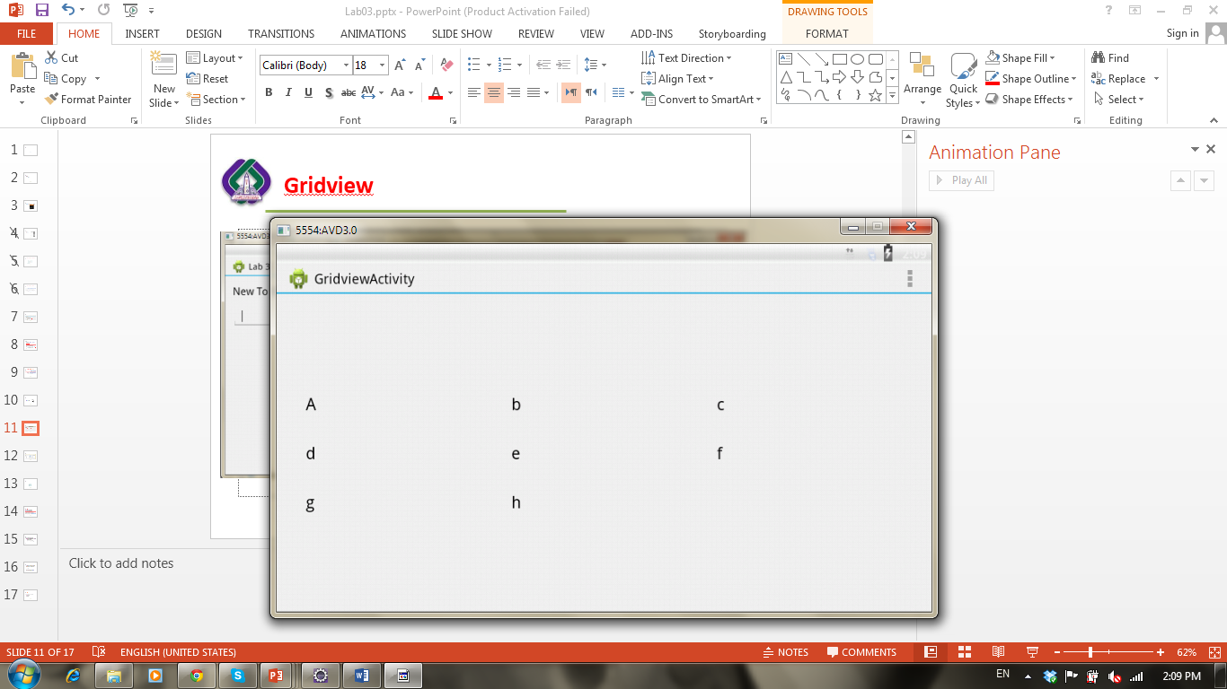
Application

Slide 9
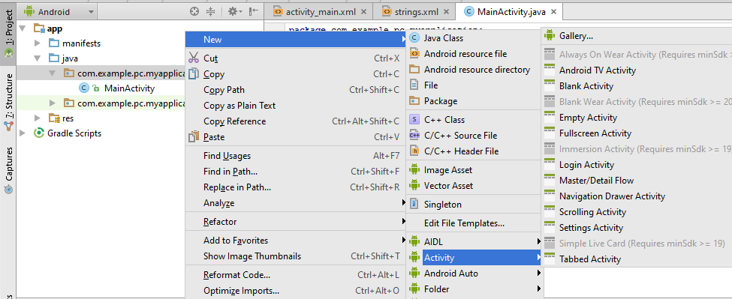
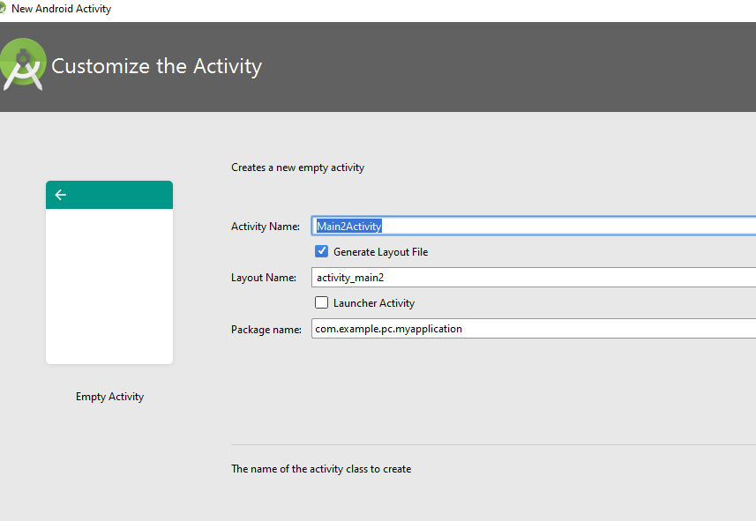
Creating new activity

Slide 10
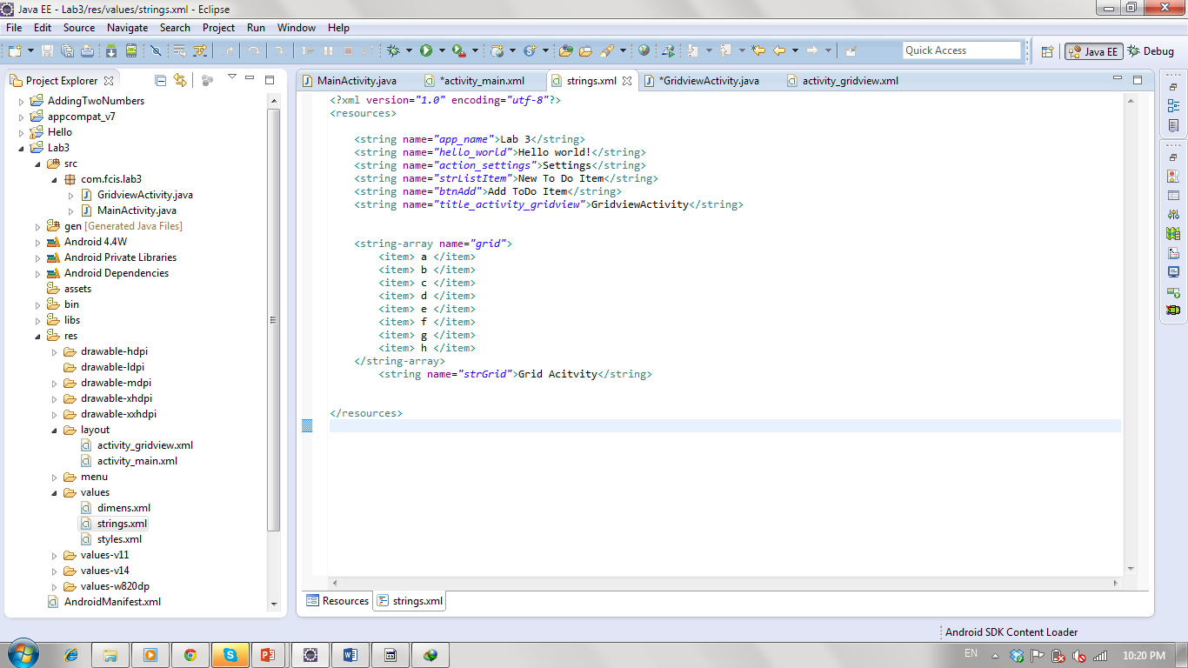
Array of values

Slide 11
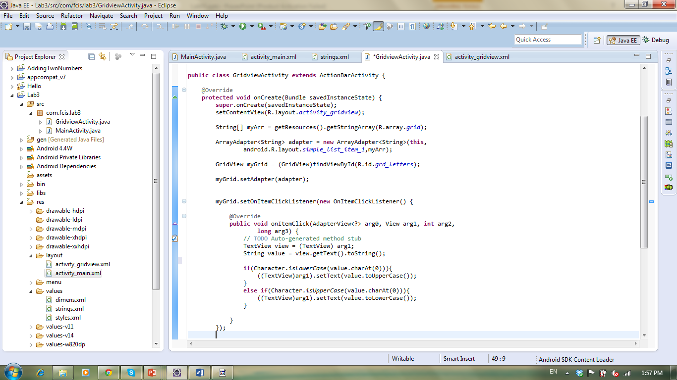
Second Activity: Binding array to grid view
Retrieve Array from strings file into array of strings
Use ArrayAdapter to Bind array of strings to the gridview
Get gridview
Set gridview’s Adapter with our Adapter
Notes:
listOfItem.add(String item);
toDoItemsAdapter.notifyDataSetChanged(); // the adapter
Where listOfItem is an Arraylist that will be linked to the gridview instead of using String[]

Slide 12
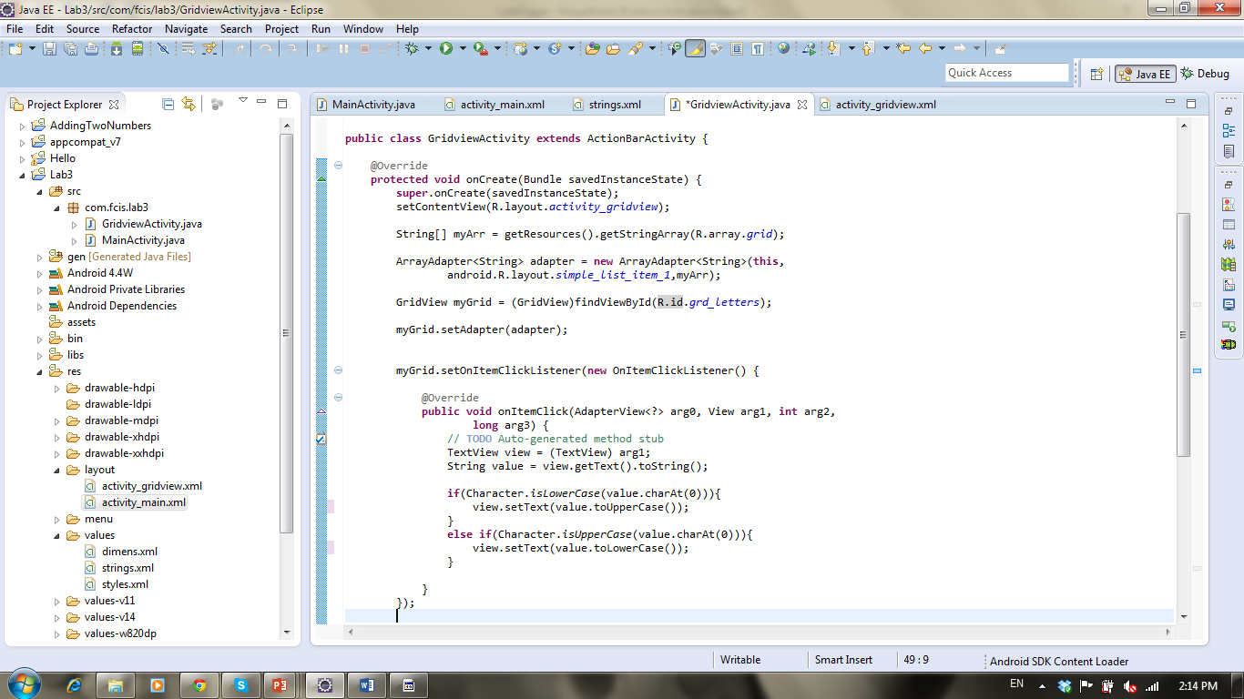
Second Activity: Grid Click Listener
Get textview and it’s value
Check if character is in a lower case then convert to upper
Check if character is in a upper case then convert to lower

Slide 13
Intents
Intents support interaction between any of the application components available on an Android device, no matter which application they’re part of.
Android supports explicit and implicit intents.
Explicit Intents: explicitly define the component which should be called by the Android system, by using the Java class as identifier.
Intent i = new Intent(this, ActivityTwo.class);
Implicit Intents: Implicit intents specify the action which should be performed and optionally data which provides content for the action.
The run time will choose the Activity to open
Intent i = new Intent(Intent.ACTION_VIEW, Uri.parse("http://www.vogella.com"));
Notes:
http://www.vogella.com/tutorials/AndroidIntent/article.html#intents_filter
Implicit intent: https://androiddesk.wordpress.com/tag/implicit-intent-using-an-example/

Slide 14
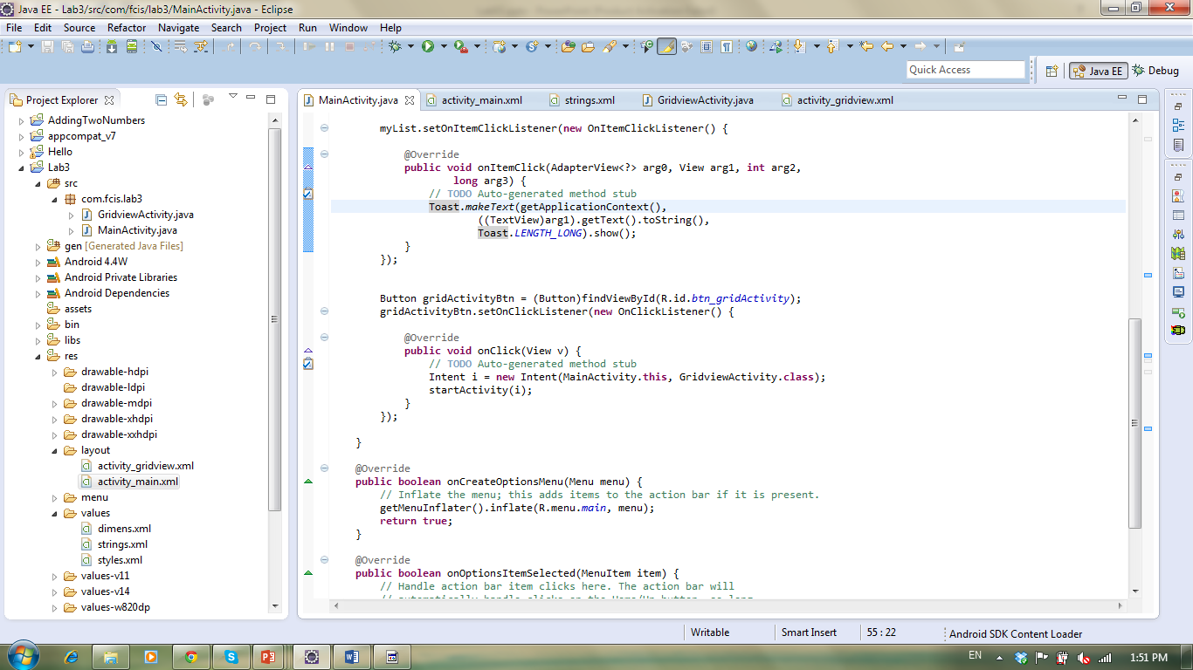
First Activity: How to navigate to another activity
Define an intent and start it
Notes:
You can use Intents to support interaction between any of the application components available on an Android device, no matter which application they’re part of. This turns a collection of independent components into a single, interconnected system.
Intents can also be used to broadcast messages across the system. Any application can register a Broadcast Receiver to listen for, and react to, these broadcast Intents.
The Intent can either explicitly specify the class to open, or include an action that the target should perform. In the latter case, the run time will choose the Activity to open

Slide 15



Options Menu
Press MENU key in an Activity.
Supports icons, but not checkboxes or radio buttons.
Notes:
Tag for icon: android:icon="@drawable/ic_launcher“
Shortcut: android:alphabeticShortcut="y“
android:numericShortcut="1“
The Expanded Menu The expanded menu is triggered when a user selects the More Menu Item from the icon menu.
displays a scrollable list of only the Menu Items that weren’t visible in the icon menu. This menu displays full text, shortcut keys, and checkboxes/radio buttons as appropriate.It doesn’t display icons.
Pressing the Back button closes the expanded menu and navigate back to the option menu
If you've developed your application for Android 2.3.x (API level 10) or lower, the contents of your options menu appear at the bottom of the screen when the user presses the Menu button When opened, the first visible portion is the icon menu, which holds up to six menu items. If your menu includes more than six items, Android places the sixth item and the rest into the overflow menu, which the user can open by selecting More.

Slide 16
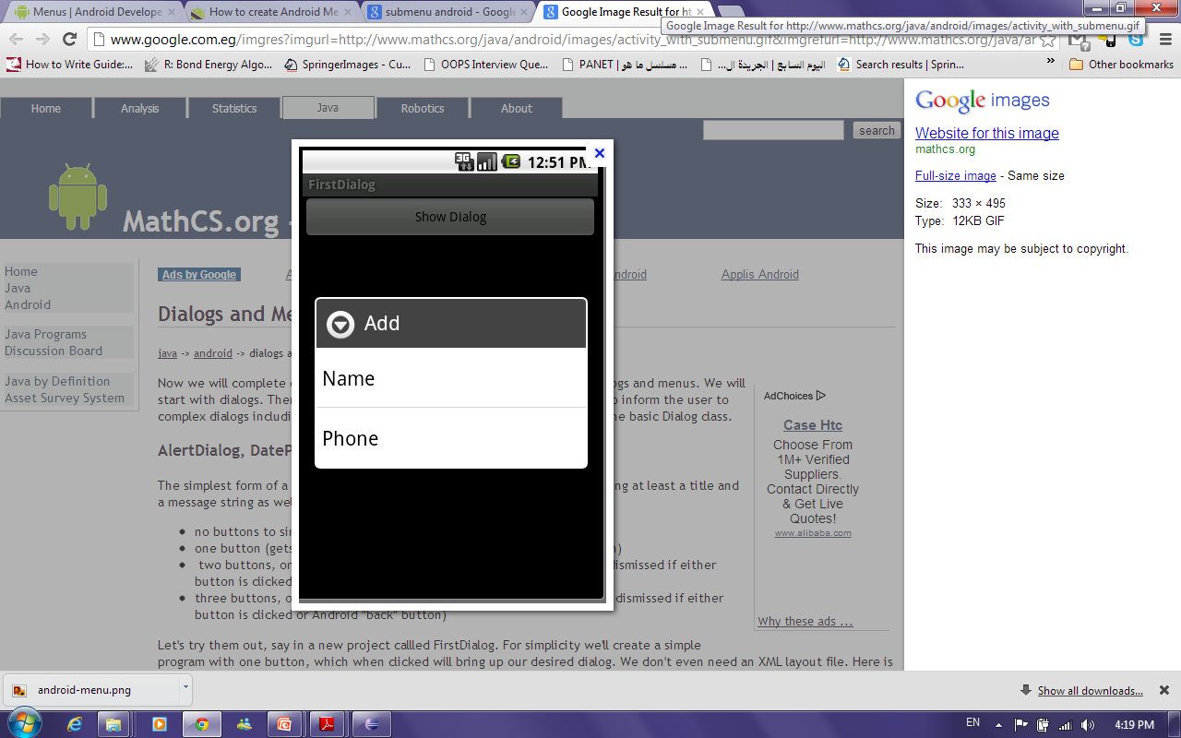
Sub Menu
Menu for a menu item.
Sub menus do not support nested sub menus.

Slide 17
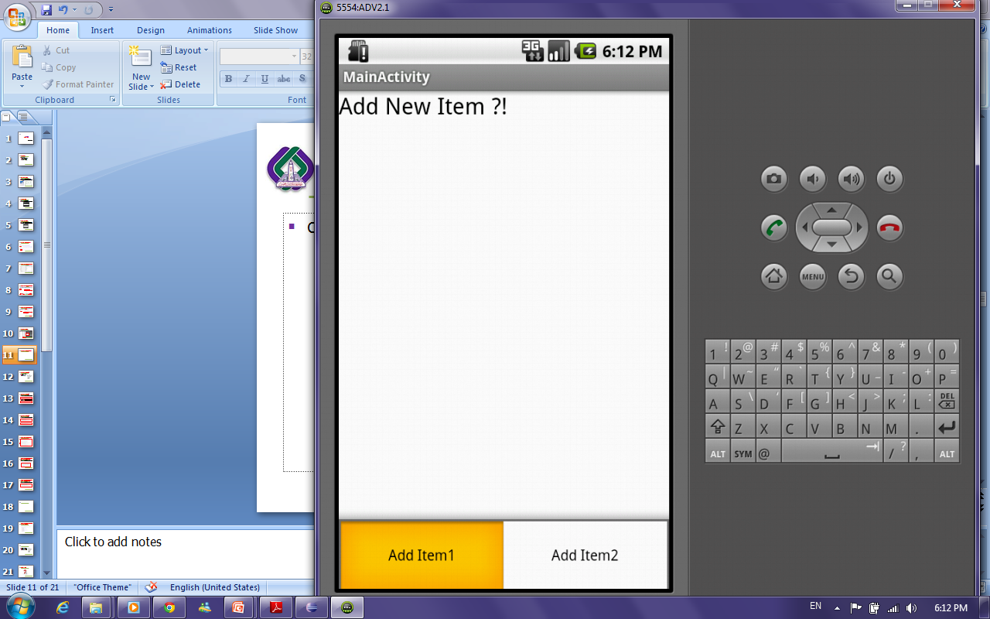
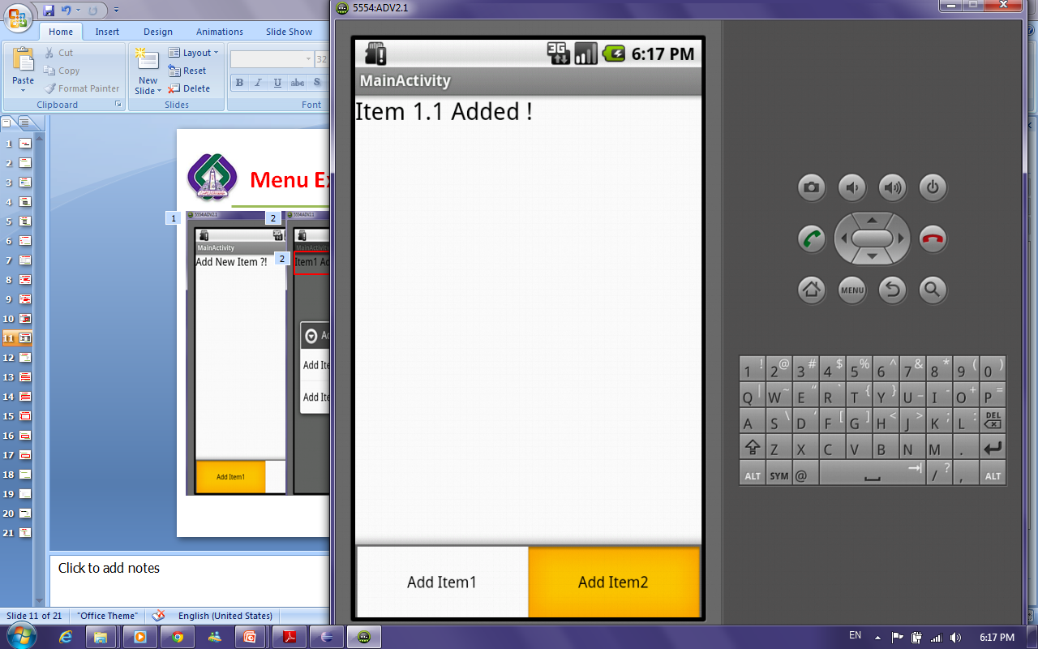
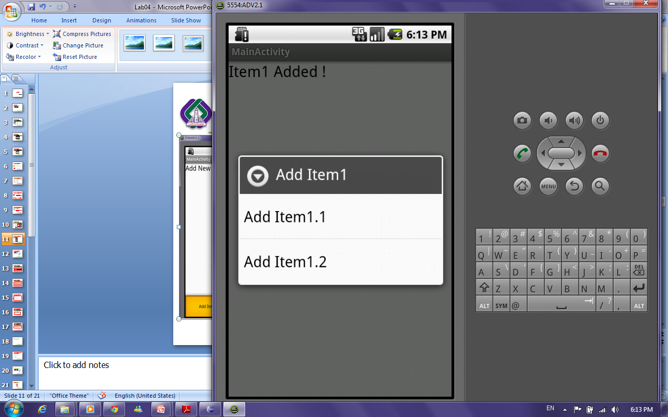
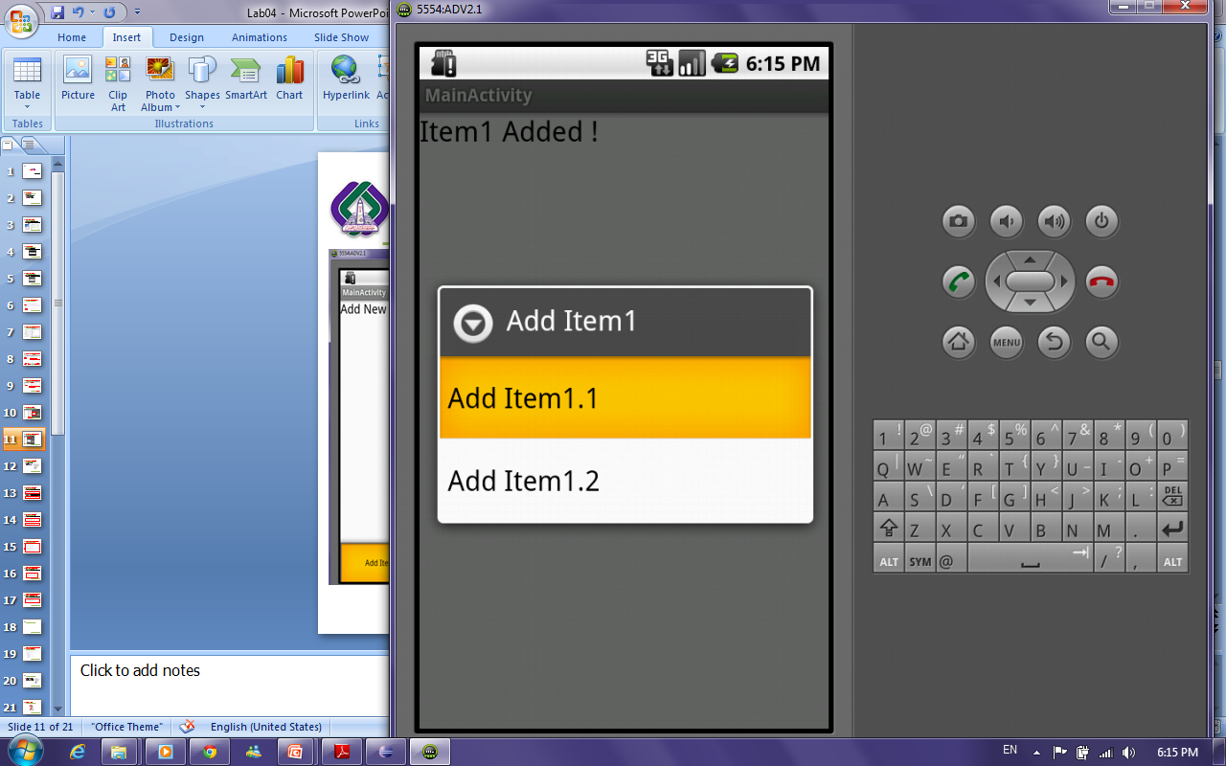
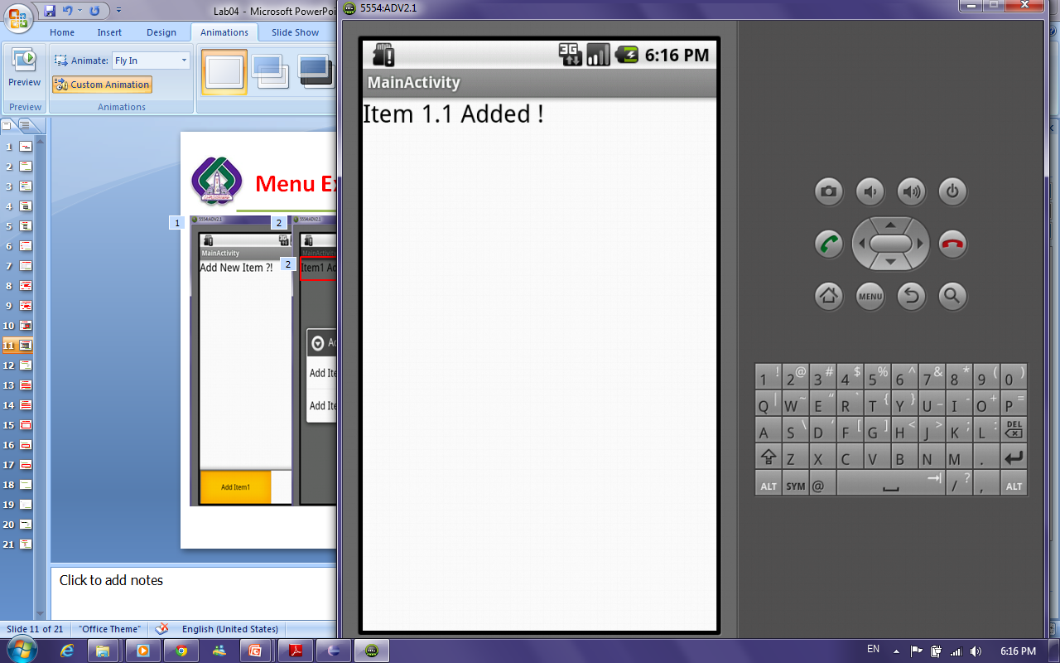
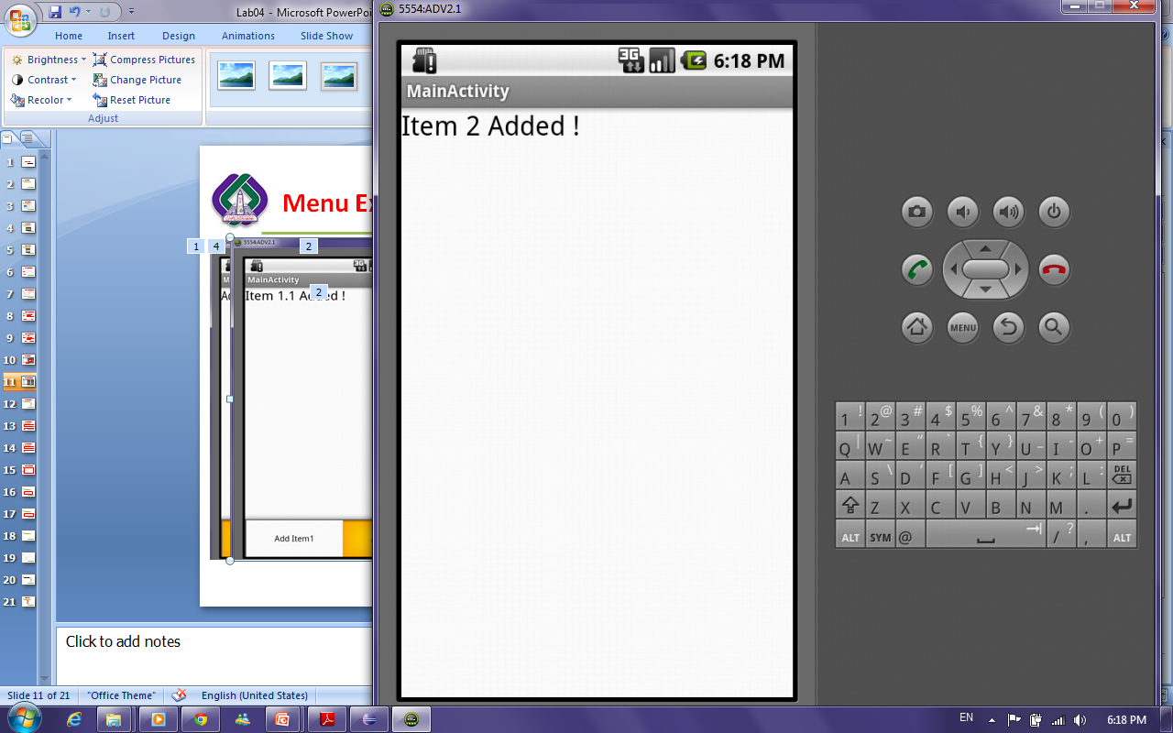
Options and Sub Menu Example

Slide 18
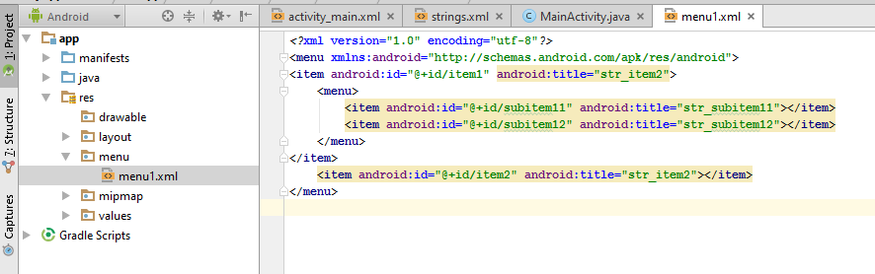
Where the menus exist !!
Notes:
@id and @+id
http://stackoverflow.com/questions/11160954/what-is-the-difference-between-id-and-id

Slide 19
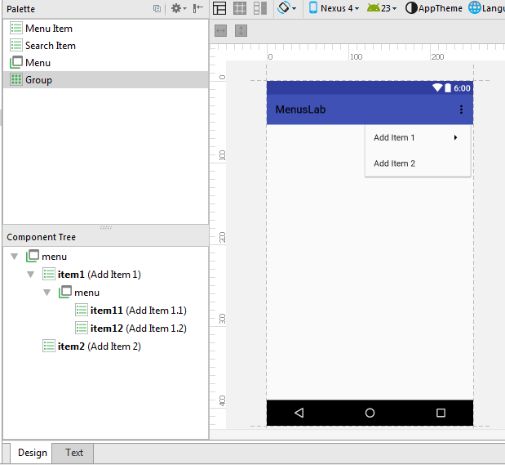
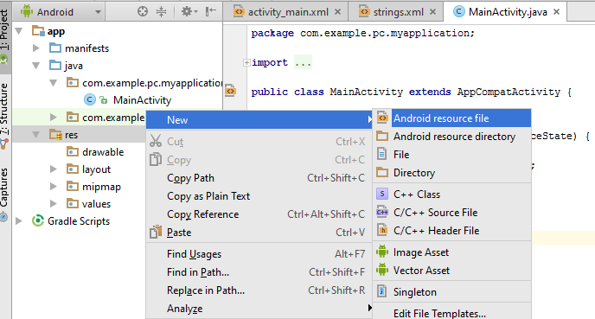
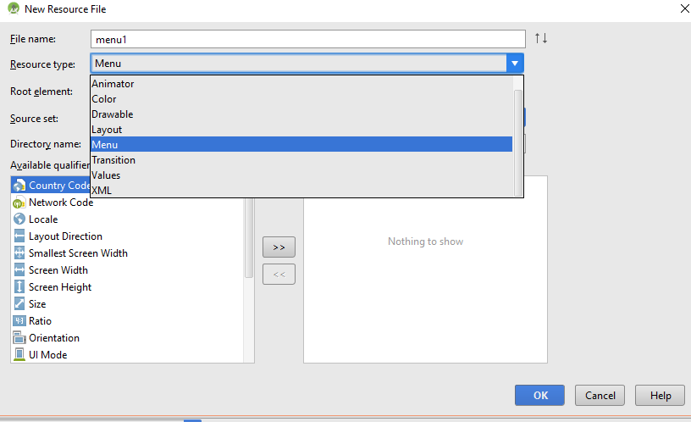
How to add menu file !!
Notes:
Menu Resource Attributes:
http://developer.android.com/guide/topics/resources/menu-resource.html
ocClick: takes the method name to execute
If room: If there's not enough room for the item in the action bar, it will appear in the action overflow.
With text:If your menu item supplies both a title and an icon—with the title and icon attributes—then the action item shows only the icon by default. If you want to display the text title, add "withText" to the showAsActionattribute.
Action view: An action view is a widget that appears in the action bar as a substitute for an action button. An action view provides fast access to rich actions without changing activities or fragments, and without replacing the action bar. For example, if you have an action for Search, you can add an action view to embeds a SearchView widget in the action bar
Action provider: Similar to an action view, an action provider replaces an action button with a customized layout. However, unlike an action view, an action provider takes control of all the action's behaviors and an action provider can display a submenu when pressed.
Because each ActionProvider class defines its own action behaviors, you don't need to listen for the action in theonOptionsItemSelected() method.
To declare an action view, use either the actionLayout or actionViewClass attribute to specify either a layout resource or widget class to use, respectively.
http://developer.android.com/guide/topics/ui/actionbar.html

Slide 20
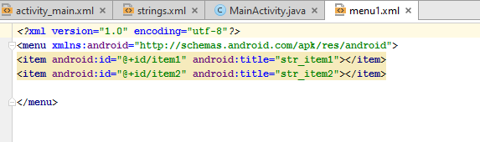
How to add options menu items:

Slide 21
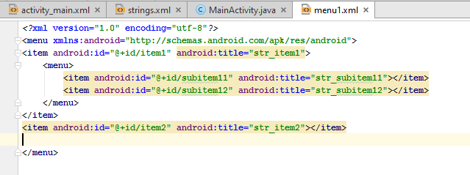
How to add submenu for a menu item !!

Slide 22
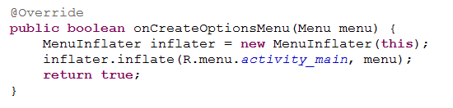
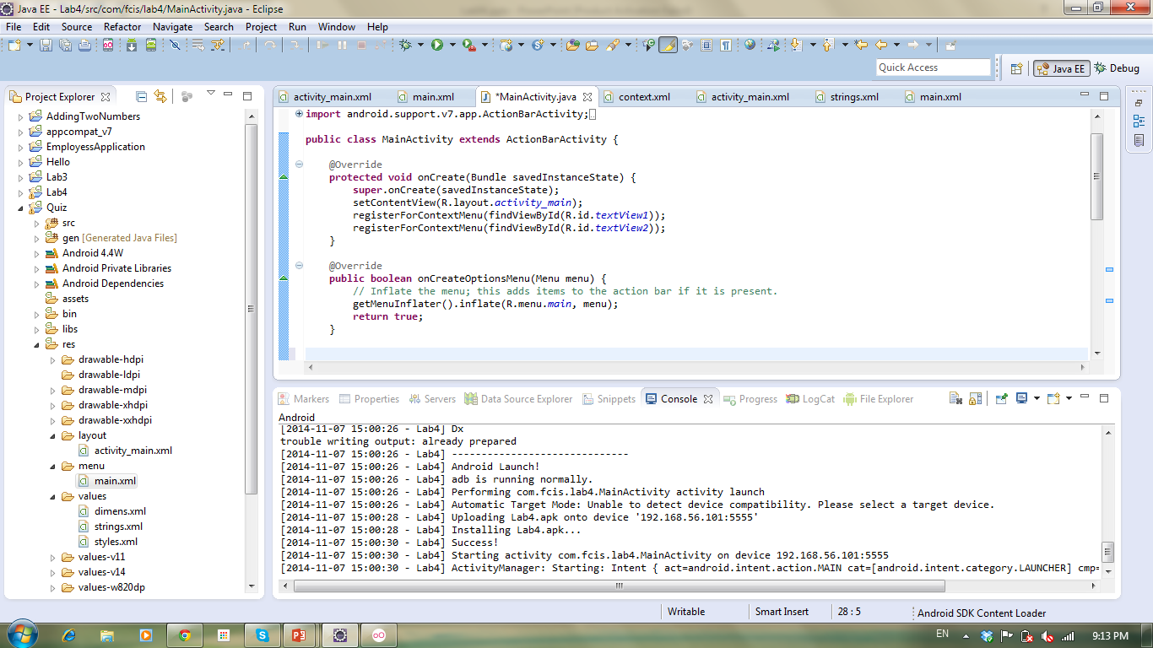
How to bind menu defined in xml file to the options menu to be shown
On the “onCreateOptionsMenu” method create object from “MenuInflater” Class and then call inflate method.
Notes:
MenuInflater: This class is used to instantiate menu XML files into Menu objects.
We can use:
MenuInflater inflater = getMenuInflater();
Instead of
MenuInflater inflater = new MenuInflater(this);

Slide 23
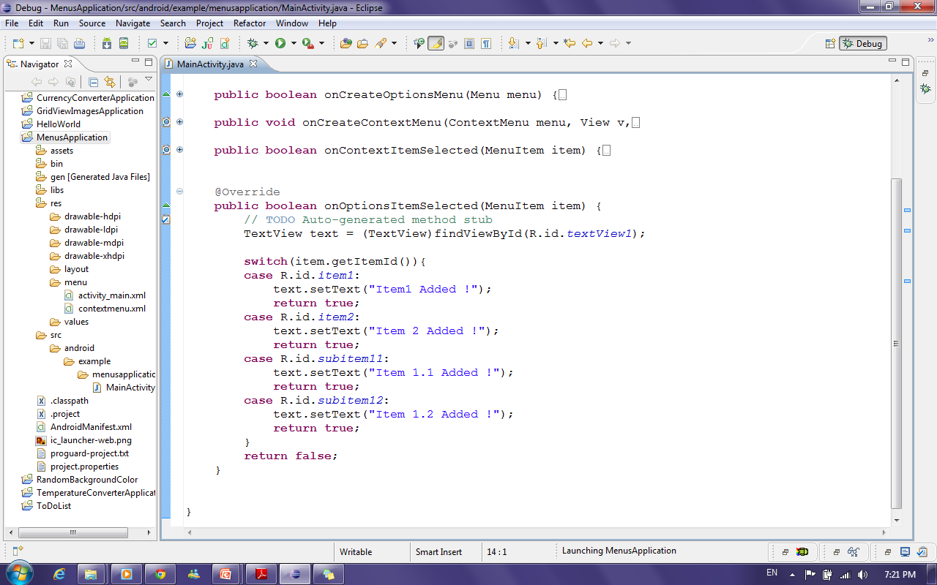
How to update TextView text when selecting any menu item from options and Sub menu?!
To handle event of selecting a certain options menu item use the “onOptionsItemSelected “ method
Get TextView
Check which item is
selected from options Menu and update TextView Text

Slide 24
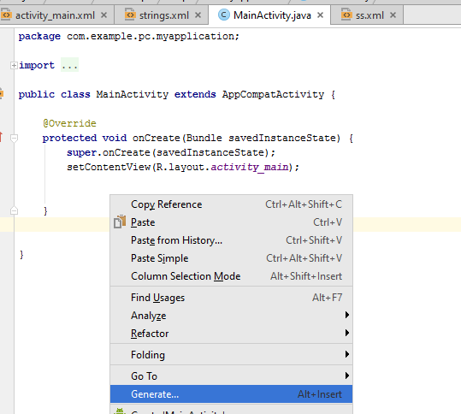
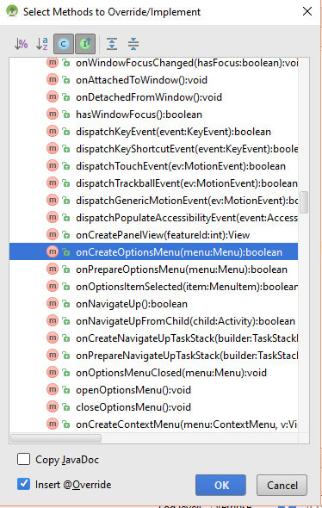
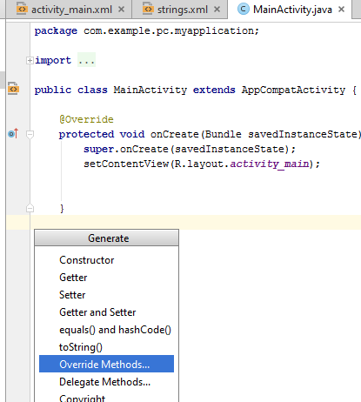
How to override Methods ?!

Slide 25
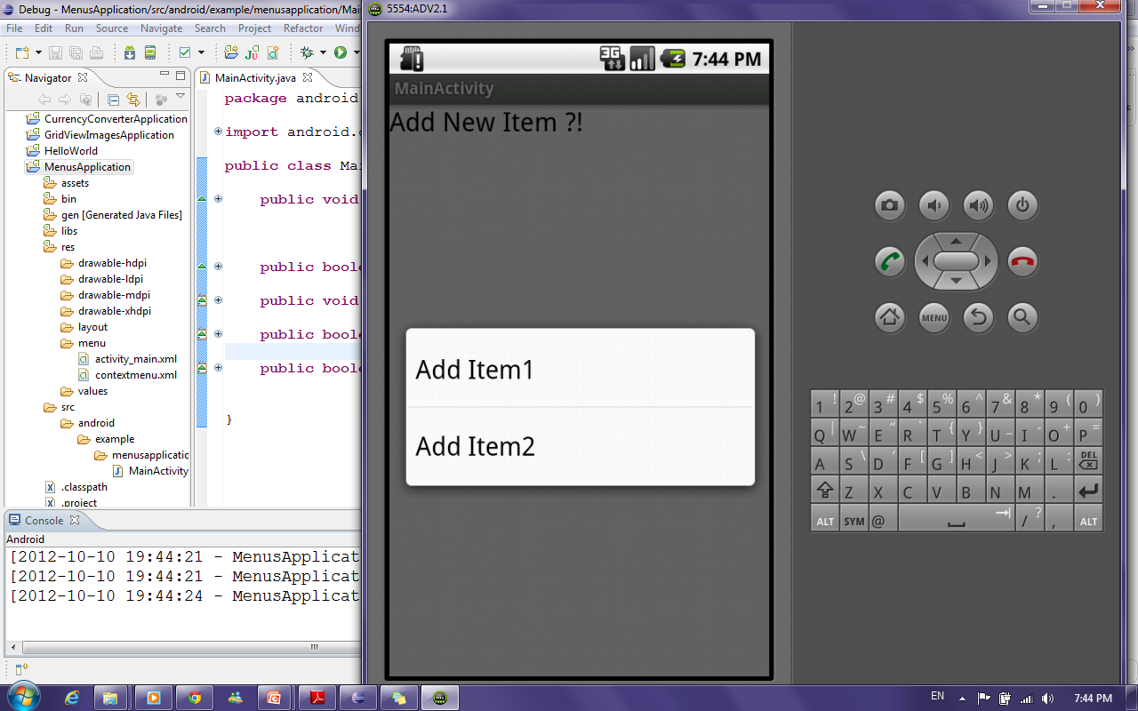
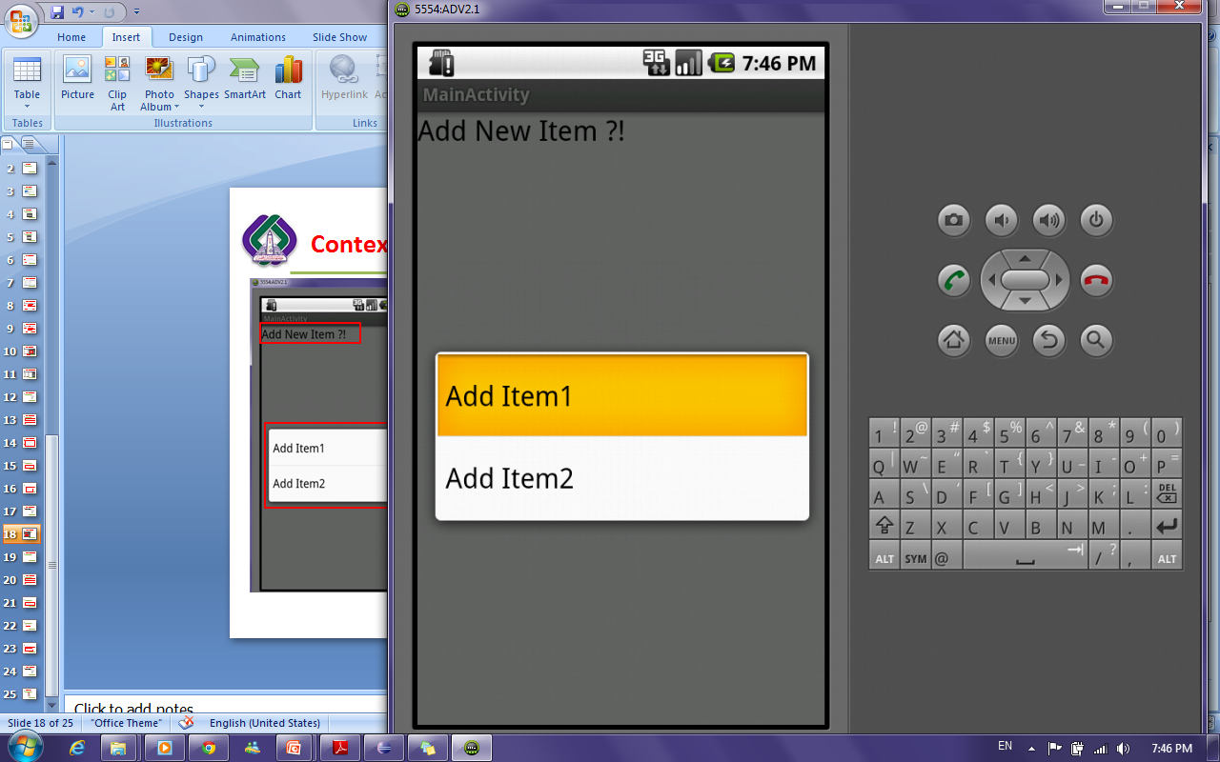
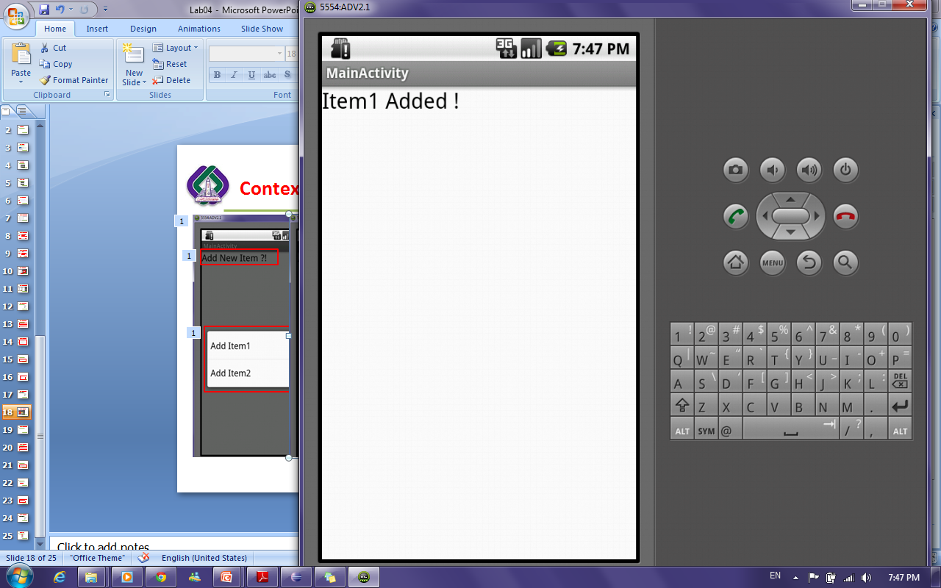
Context Menu Example

Slide 26


Context Menu Example Cont’
To Show context menu when long-pressing TextView, Override the “onCreateContextMenu” method
To handle event of selecting a certain context menu item, Override the “onContextItemSelected” method

Slide 27
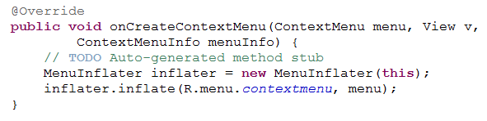
How to bind menu defined in xml file to the context menu to be shown
On the “onCreateContextMenu” method create object from “MenuInflater” Class and then call inflate method.

Slide 28
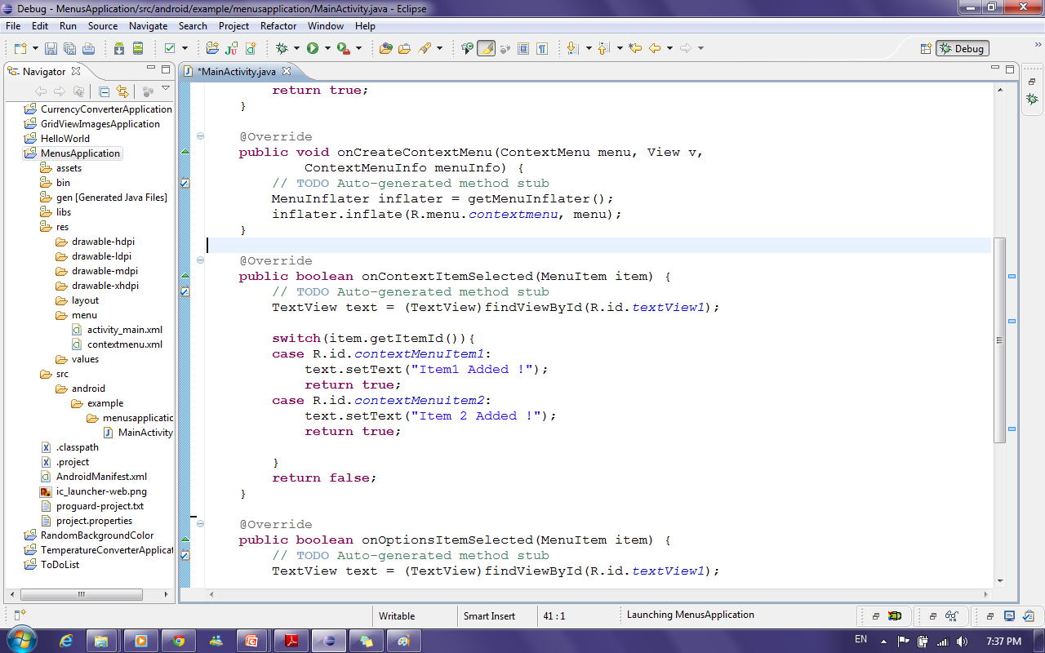
How to update TextView text when selecting any menu item from Context menu?!
Get TextView
Check which item is
selected from context Menu and update TextView Text

Slide 29
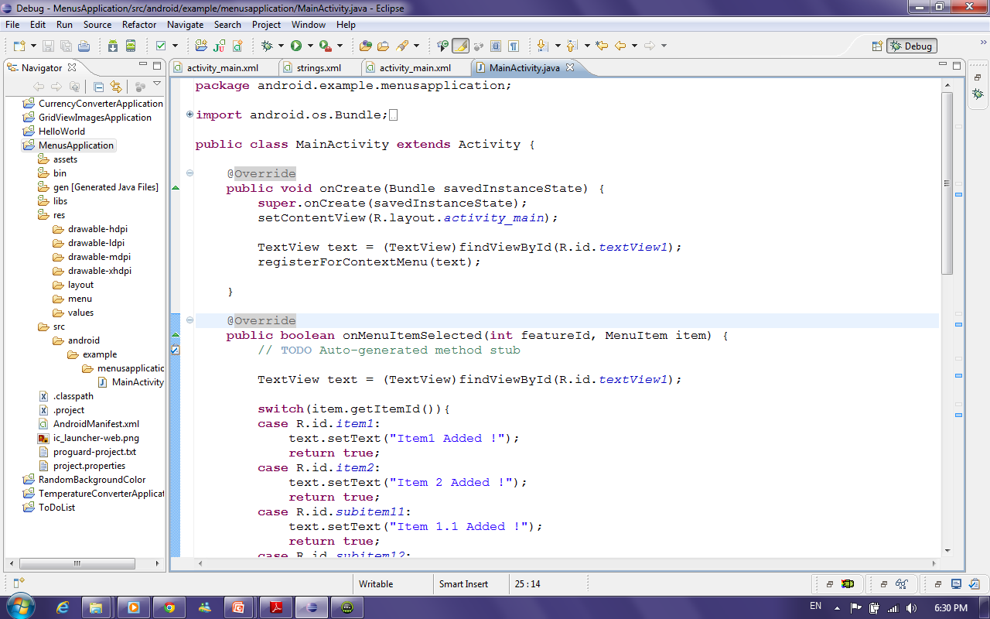
How to bind context menu with TextView ?!
In the OnCreate Method of the activity
Get TextView
Bind Context Menu to TextView

Slide 30
SQLite
SQLite is an Open Source Database which is embedded into Android.
SQLite is available on every Android device. Using an SQLite database in Android does not require any database setup or administration.
Notes:
SQLite dataTypes: https://www.sqlite.org/datatype3.html
Text
Integer
Numeric
Real
None

Slide 31
SQLiteOpenHelper
SQLiteOpenHelper is the helper class provided by android to create and maintain databases for your application.
This class takes care of opening the database if it exists, create it if it does not exist, and upgrade it as necessary.
In this class you need to override the methods onCreate() to create the database and onUpgrade() to upgrade the database in case of changes in the database schema.

Slide 32
SQLiteOpenHelper Cont’
SQLiteOpenHelper provides the methods getReadableDatabase() and getWriteableDatabase() to get access to an SQLiteDatabase object which allows database access either in read or write mode.

Slide 33
SQLiteDatabase
SQLiteDatabase is the base class for working with a SQLite database in Android.
SQLiteDatabase provides:
insert(), update() and delete() methods.
execSQL() method, which allows to execute an SQL statement directly.
The object ContentValues allows to define key/values.
The "key" represents the table column identifier
The "value" represents the content for the table record in this column.
ContentValues can be used for inserts and updates of database entries.
Queries can be created via the rawQuery() and query() methods
rawQuery() directly accepts an SQL select statement as input.
query() provides a structured interface for specifying the SQL query.
Notes:
and provides methods to open, query and update database .

Slide 34
Cursor
A Cursor represents the result of a query and basically points to one row of the database.
Notes:
A query returns a Cursor object.

Slide 35
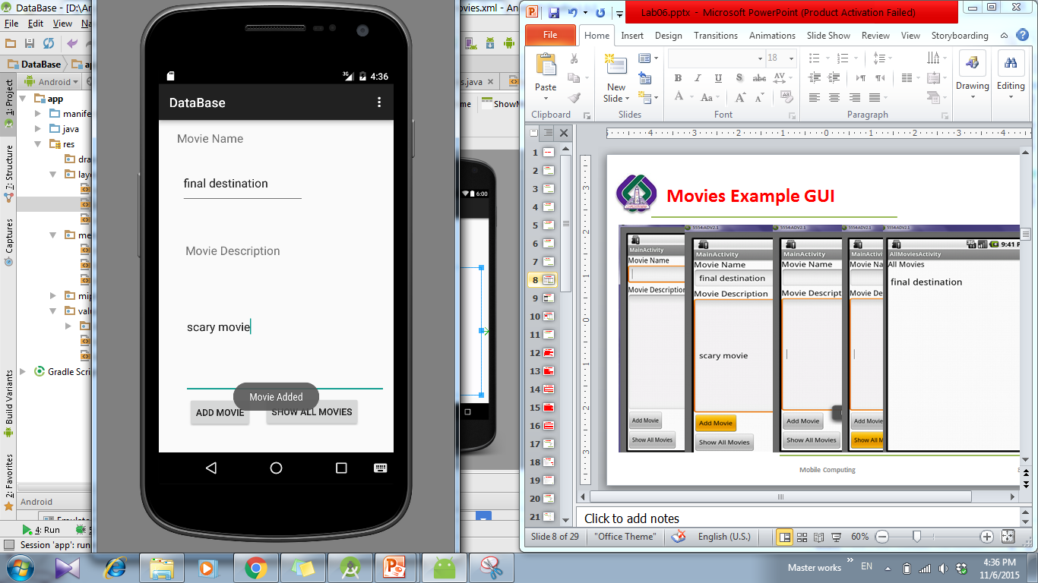
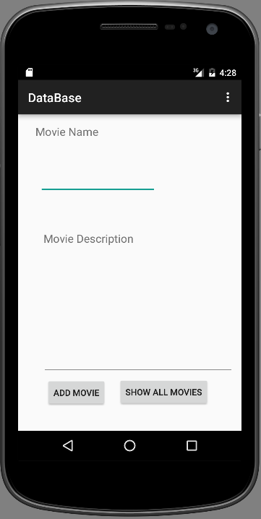
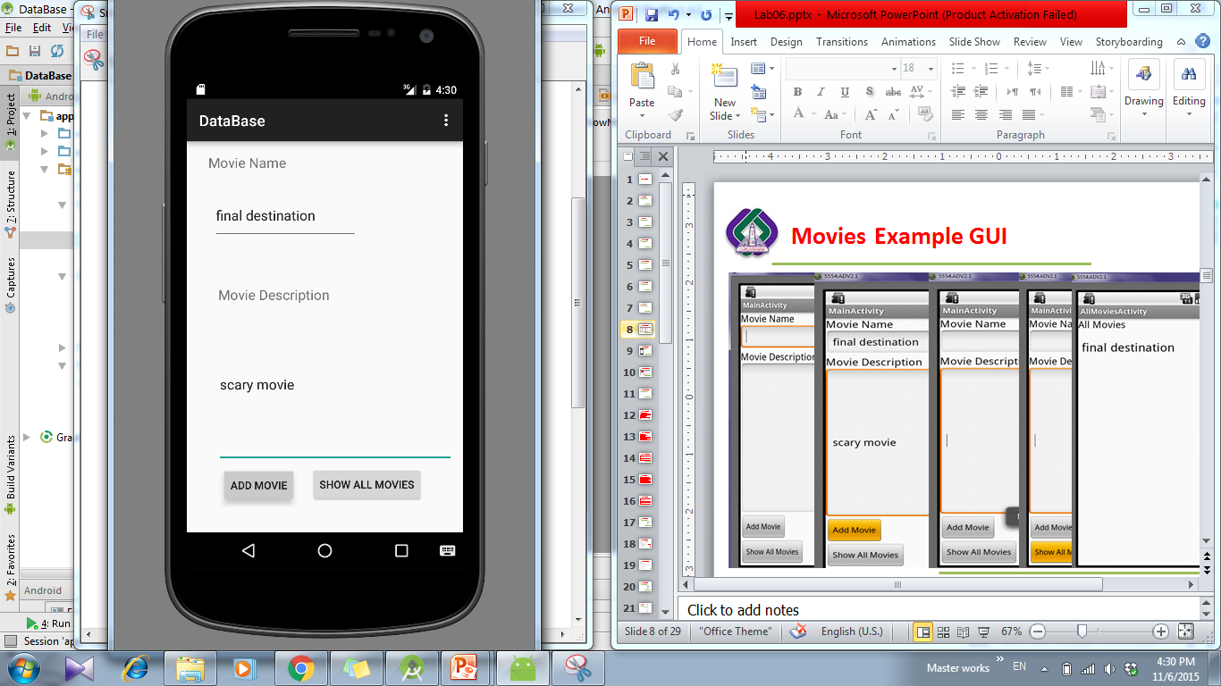
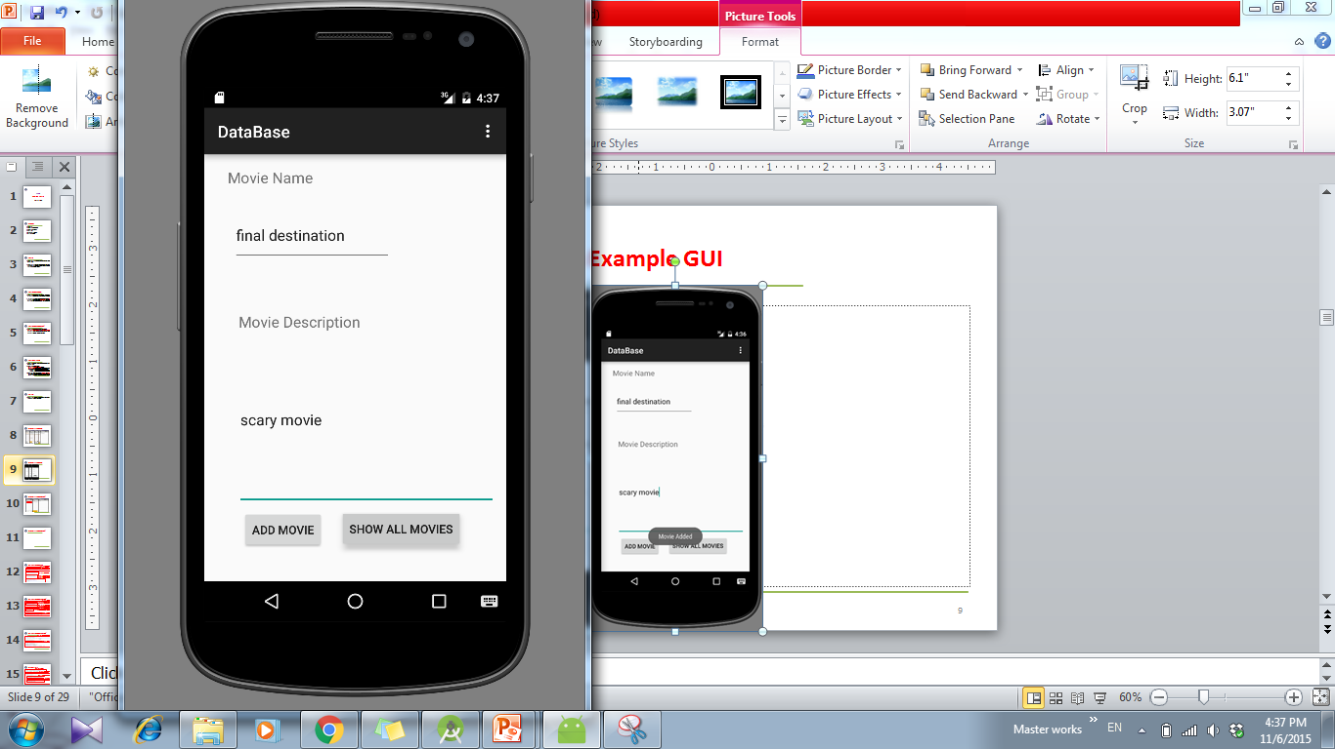
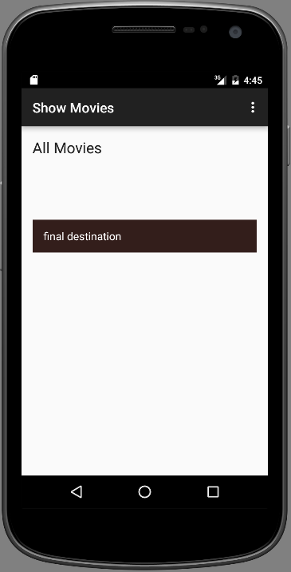
Movies Example GUI

Slide 36
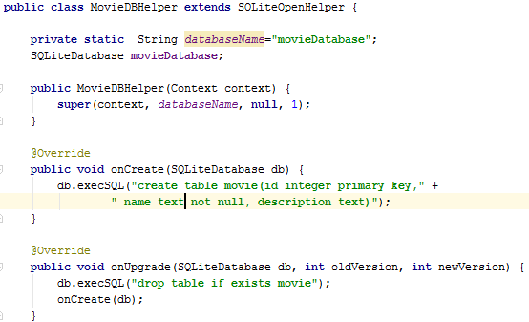
DatabaseHelper Class
Extends SQLiteOpenHelper Class
Specify DB name
Create object from SQliteDatabase
Create the constructor
Override the onCreate method that executes the DB creation Statement
Override the onUpgrade method
36
Notes:
http://developer.android.com/reference/android/database/sqlite/SQLiteOpenHelper.html
onCreate() is called by the framework, if the database does not exists.
onUpgrade() is called, if the database version is increased in your application code. This method allows you to update the database schema.
Both methods receive an SQLiteDatabase object as parameter which represents the database.
SQLite supports the data types TEXT (similar to String in Java), INTEGER (similar to long in Java), Blob: Array of binary data (bytes) and REAL (similar to double in Java). All other types must be converted into one of these fields before saving them in the database.
Why static DBName? this happens because Instance Variables are created once its constructor is called but here in this case before the child's constructor its parent Constructor gets executed.. which means instance variables/object of child class doesn't exist in the Heap. or in other words they are not constructed yet.. but in case of static variables they are first one's getting executed thus they have some values and that works perfectly fine..
cursorFactory: The reason of passing null is you want the standard SQLiteCursor behaviour. If you want to implement a specialized Cursor you can get it by extending the Cursor class( this is for doing additional operations on the query results). And in these cases, you can use the CursorFactory class to return an instance of your Cursor implementation.
When does onCreate() upgrade() methods call?
SQLiteOpenHelper onCreate() and onUpgrade() callbacks are invoked when the database is actually opened, for example by a call to getWritableDatabase() or getReadableDatabase(). The database is not opened when the database helper object itself is created.
SQLiteOpenHelper versions the database files. The version number is the int argument passed to the constructor. In the database file, the version number is stored in PRAGMA user_version. onCreate() is only run when the database file did not exist and was just created.
onUpgrade() is only called when the database file exists but the stored version number is lower than requested in constructor. The onUpgrade() should update the table schema to the requested version.
Primary key auto increment:
http://stackoverflow.com/questions/4388459/how-to-make-auto-increment-on-android-sqlite-database

Slide 37
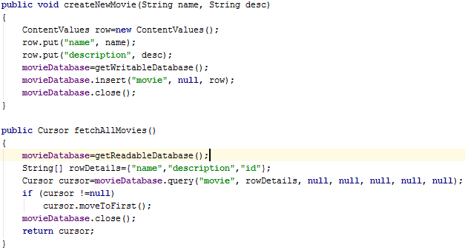
DatabaseHelper Class Cont’
Create a new row Object using ContentValues
Adding columns to the row “Name and Desc”
initialize database object to update database
Insert that row to the DB
initialize database object to update database
Define Cursor that will hold returned rows
Define columns returned in each row
If there are rows in cursor , let it point to the first row
Notes:
http://developer.android.com/reference/android/database/sqlite/SQLiteDatabase.html
We use public long insert (String table, String nullColumnHack, ContentValues values) API to create a new row into the table.
ContentValues a (key,value) pair is the actual row detail. Key is the column name and value is the column value.
We use public Cursor query(String table, String[] columns, String selection, String[] selectionArgs, String groupBy, String having, String orderBy) API to query/read all rows from the table.
We use public int delete (String table, String whereClause, String[] whereArgs) API to delete a row from the table.
We use public int update (String table, ContentValues values, String whereClause, String[] whereArgs)API to update/edit a row in the table.
nullColumnHack: Let's suppose you have a table named foo where all columns either allow NULL values or have defaults.
In some SQL implementations, this would be valid SQL:
`INSERT INTO `foo;That's not valid in SQLite. You have to have at least one column specified:
INSERT INTO foo (somecol) VALUES (NULL);Hence, in the case where you pass an empty ContentValues to insert(), Android and SQLite need some column that is safe to assign NULL to.
selectionArgs:
String[] args = { "first string", "second@string.com" };
Cursor cursor = db.query("TABLE_NAME", null, "name=? AND email=?", args, null);

Slide 38

MainActivity
Get All the Views
Create MovieDatabaseHelper Object
Get texts and create new movie
Add actionListener to add_btn
38

Slide 39

Main Activity Cont’
Add actionListener to gettAllMovies_btn
Define the intent and start activity

Slide 40

ShowMovies Activity
Global Variables
Get ListView and Set its Adapter
Create MovieDatabaseHelper Object
Create cursor object to point to fetched movies
Get the movie name and add it to the ArrayAdapter then move to the next movie

Slide 41
Thanks

